Slide 1
Text Classifier with BERT for Disastrous Tweets
By: Mofei Shi
13284676
Notes:
Hello, this is the oral presentation for course 32933.
I am mofei shi, my project is Text Classifier with BERT for disastrous Tweets

Slide 2
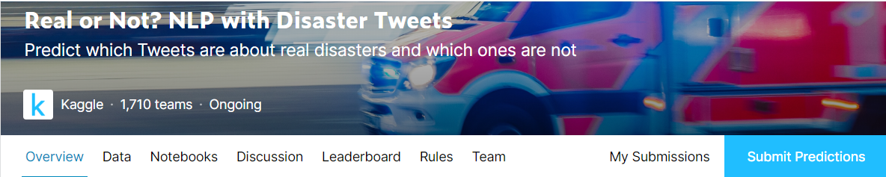
A Kaggle Competition: Real or Not.
The current research is based on a competition on the Kaggle.com.
Kaggle Competitions are online data science challenges open to anyone.
Notes:
The current research is based on a competition on the Kaggle.com.
Kaggle Competitions are online data science challenges open to anyone.

Slide 3

Real or Not
We live in troubling times now. Disasters small or big, become part of our lives.
We need real-time information about disasters and respond accordingly.
Notes:
We live in troubling times now. Disasters small or big, become part of our lives. We need real-time information about disasters and respond accordingly.

Slide 4
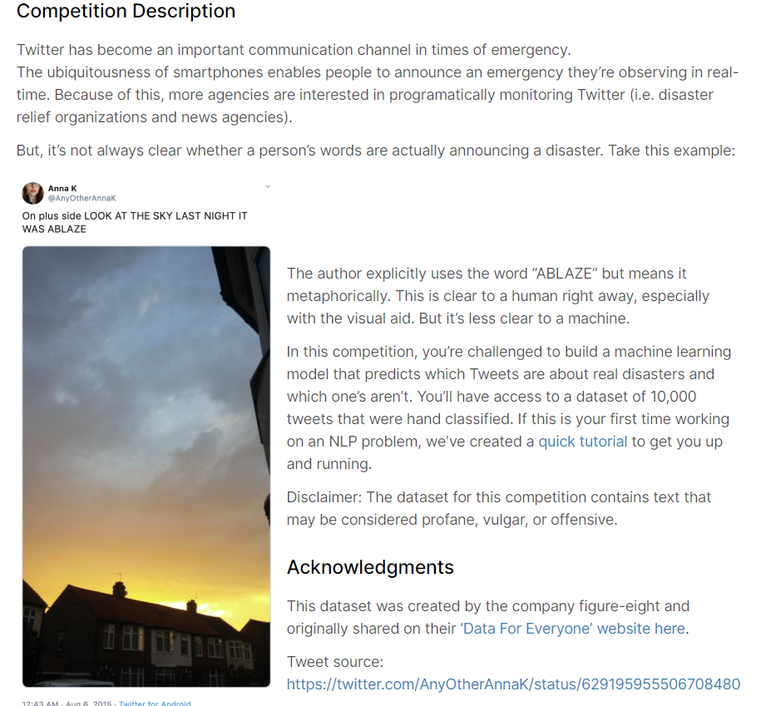
Real or Not
One way the news agencies and the government can do is monitor social media to widen the stream of information.
As of the fourth quarter of 2019, Twitter had 152 million monetizable daily active users worldwide.
But there needs to be a way to classify the disastrous tweets and irrelevant tweets.
Notes:
One of the way news agencies and governments can do is monitoring social media to widen the stream of information. For example, they can monitor the posts on twitter: tweets.
Tweets from 152 millions of users can help news agencies and governments to react to disasters quickly. They can also help governments to estimate the influence of a disastrous event. But there needs to be a way to distinguish the disastrous tweets from the irrelevant tweets.

Slide 5
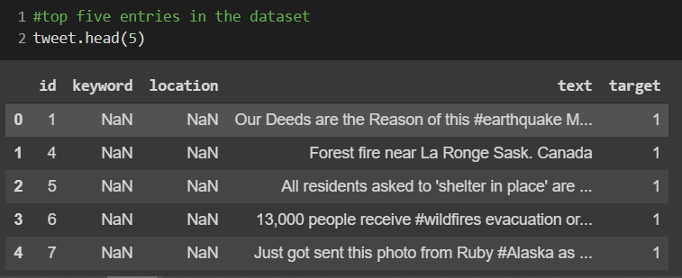
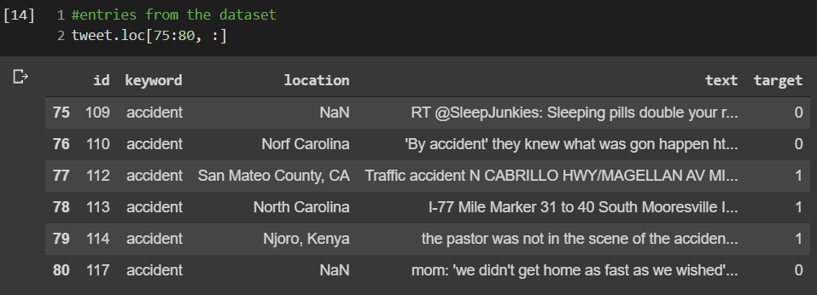
Real or Not
The Competition provides participants with a labelled dataset.
The training dataset has the following five columns:
id: the unique id of a tweet within this dataset.
keyword: the theme of the tweet.
location: the location tag of the tweet.
text: the textual content of the tweet.
target: these labels denotes whether or not a tweet is about a disaster.
Notes:
The Competition provides participants with a labelled dataset to work with.
The training dataset has the following five columns:
id: the unique id of a tweet within this dataset.
keyword: the theme of the tweet. (what kind of disaster)
location: the location tag of the tweet.
text: the textual content of the tweet. (this is what will be used for classification)
target: this label denotes whether or not a tweet is about a disaster. (1 means the tweet is about disaster , 0 stands for irrelevant tweets)

Slide 6
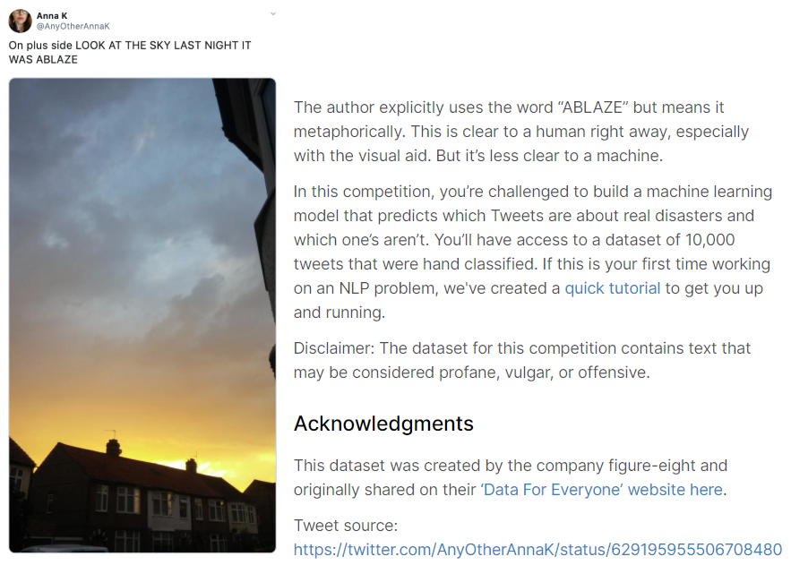
Natural Language Processing (NLP) Problem
The research problem can be generally described as a tweets classification problem.
Word sense ambiguity problem in NLP:
Find the correct interpretation of words, based on the context of the sentence.
Notes:
The research problem can be generally described as a tweets classification problem. One of the pre-conceived challenges is the word sense ambiguity problem in NLP. For example, in the example given by the competition. The tweet: “On plus side look at the sky last night it was ablaze.” is not about a disaster. It might be hard for a machine to tell, especially without the visual aid. Because the word ‘ablaze’ is in it. The challenge of word sense ambiguity is to find the correct interpretation of words, based on the context of the sentence. The context is the key.

Slide 7
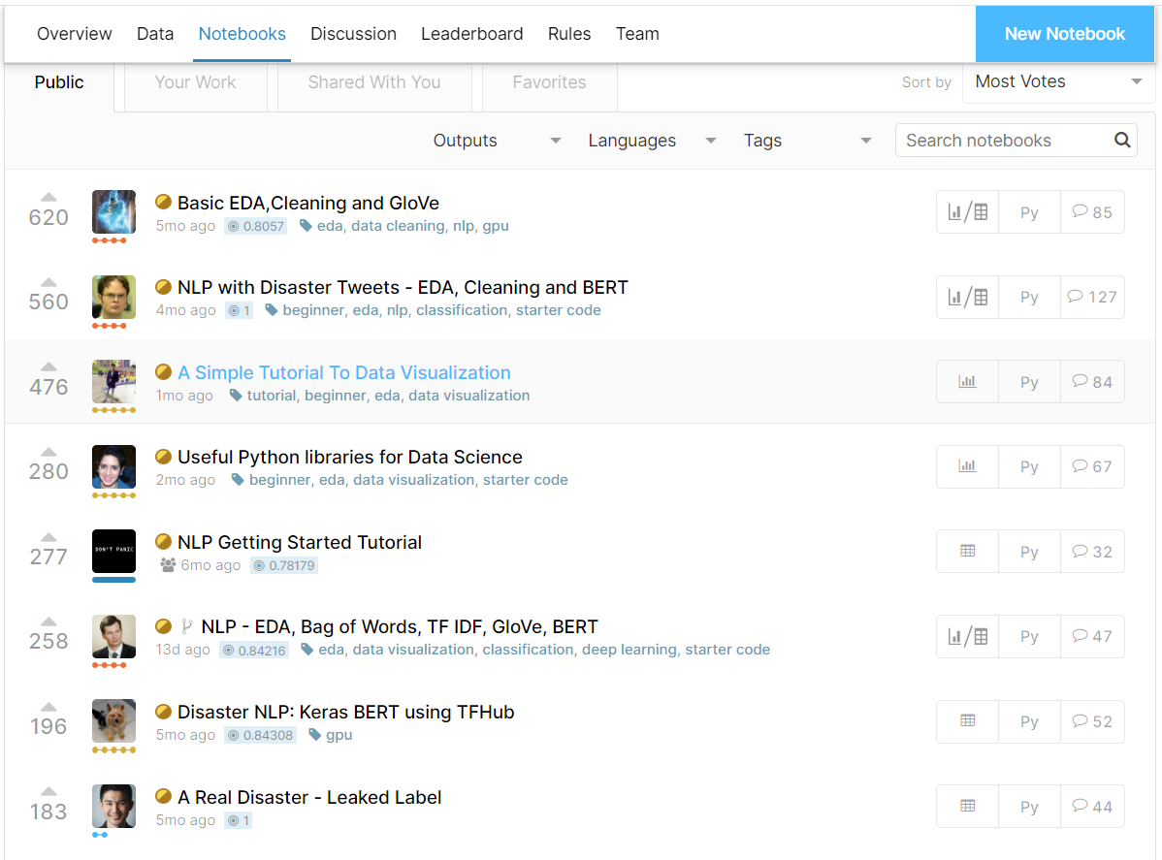
Previous Methods
Study the solution of the other participants in the competition:
1. There is testing dataset with leaked labels.
2. The most prominent participants all used deep learning neural networks. One being BERT, the other one is GolVe.
Notes:
Study the solution of the other participants in the competition: (I found)
There is testing dataset with leaked labels. ( so the competition provides the participants with a training dataset with labels that indicate whether or not a tweet is about a disaster. The competition also provides a testing dataset which does’t have labels for participants to classify. Now that there is a testing dataset with leaked labels: it can explain why some participants achieved 100% accuracy. and for my purpose, I can use the dataset to test my model)
The most prominent participants all used deep learning neural networks. One being BERT, the other one is GolVe.

Slide 8
Previous Methods: GolVe and BERT
The essential steps of a deep learning model are preprocessing the data and training the model. The data need to be vectorized. Then the vectors are mapped in a data space. The deep learning model calculates the likelihood of co-occurrence between the vectors based on their distance in the data space.
GloVe embeds a word in a large number of dimensions; each dimension defines a context to deal with this problem. For instance, the glove.6B.100d.txt pre-trained word vectors file has 100 dimensions vector for a word. However, GloVe doesn’t capture the context of the sentence directly.
BERT uses another approach. It tokenizes words in the body of the text. Instead of having vectors with many dimensions, BERT vectorizes the body of the text. Further, BERT undergoes bidirectional context conditioning. It detects context from both the left and the right of the text concurrently. Since BERT is outstanding in figuring out the context, it is very suited to the current research problem.
Notes:
The essential steps of a deep learning model are preprocessing the data and training the model. The data need to be vectorized, turning text into one-hot encoding. Then the vectors are mapped in a data space. The deep learning model calculates the likelihood of co-occurrence between the vectors based on their distance in the data space. The problem is: a word in different context needs different representation.
GloVe embeds a word in a large number of dimensions; each dimension defines a context to deal with this problem. For instance, the glove.6B.100d.txt pre-trained word vectors file has 100 dimensions vector for a word. However, GloVe doesn’t capture the context of the sentence directly.
BERT uses another approach. It tokenizes words in the body of the text. Instead of having vectors with many dimensions, BERT vectorizes that body of the text. Further, BERT undergoes bidirectional context conditioning. It detects context from both the left and the right of the text concurrently. Since BERT is outstanding in figuring out the context, it is very suited to the current research problem.

Slide 9
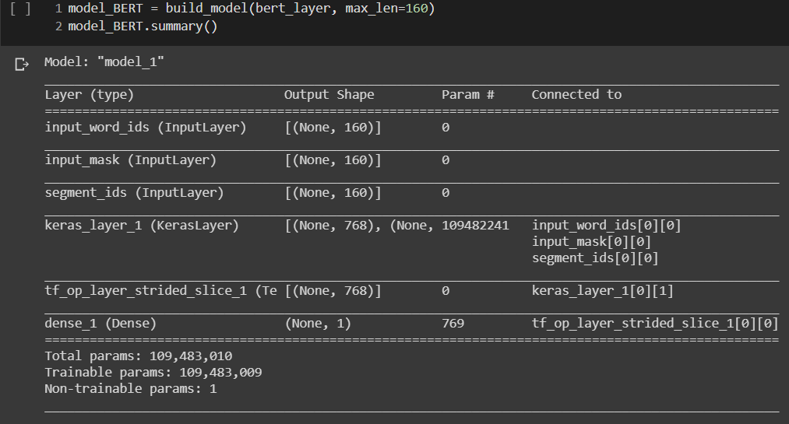
Bidirectional Encoder Representations from Transformers (BERT)
BERT is technically not a neural network. It is similar to the convolution layers in the Convolutional Neural Networks. It is designed to learn the nuances of text as they pass through it. The figure showed the BERT layer is connected with three input layers and an output classifier layer.
Notes:
BERT is technically not a neural network. It requires a classifier to produce the final result. It is similar to the convolution layers in the Convolutional Neural Networks. It is designed to learn the nuances of text as they pass through it. The figure showed the BERT layer is connected with three input layers and an output classifier layer.

Slide 10
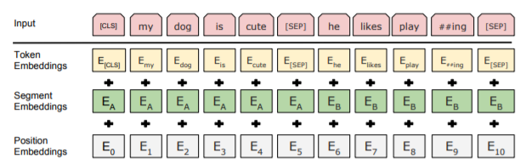
BERT: Input Layers
First, the Token Embeddings attach a [CLS] token at the beginning of the series of the tokens. It also inserts a [SEP] token at the end of a sentence. The Segment Embeddings label which segment a token belongs to. The Position Embeddings label the absolute position of a token in a series of tokens. These input layers feed to BERT concurrently.
Notes:
First, the Token Embeddings attach a [CLS] token at the beginning of the series of the tokens. It also inserts a [SEP] token at the end of a sentence. The Segment Embeddings label which segment a token belongs to. The Position Embeddings label the absolute position of a token in a series of tokens. These input layers feed to BERT concurrently.

Slide 11
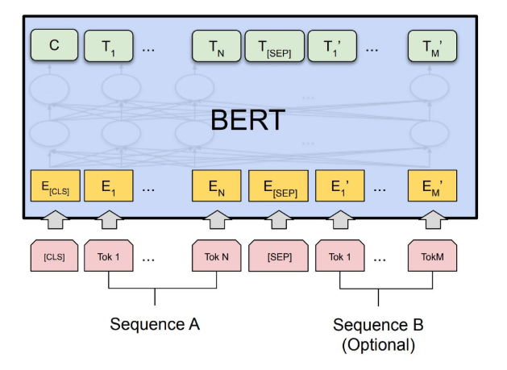
BERT: Encoder Layers
In the encoding step, the encoding layer uses learned word embedding to convert the tokens into 512-D word embedding vectors. They will go through an attention-based encoder. Then an encoder will output the same number of 512-D vectors.
The output of BERT is connected to a machine learning classifier to produce the final output.
Notes:
In the encoding step, the encoding layer uses learned word embedding to convert the tokens into 512-D word embedding vectors. They will go through an attention-based encoder. Then an encoder will output the same number of 512-D vectors.
The output of BERT is connected to a machine learning classifier to produce the final output.

Slide 12
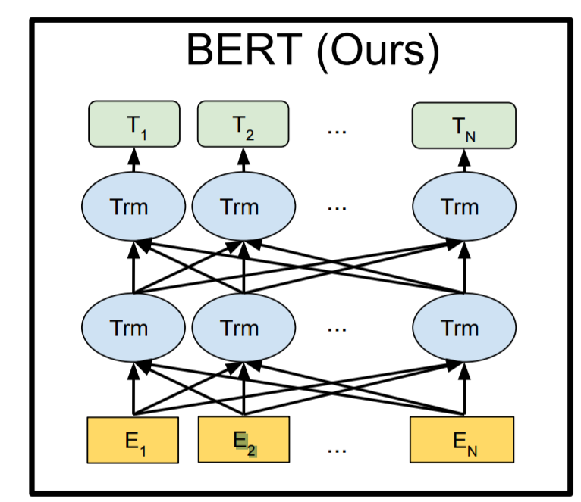
BERT: Bidirectional context conditioning
For a body of text, all tokens were vectorized and passed to the attentions of an encoder layer. The layer modifies the vectors and passes to the next encoder layer. Same as before, all vectors were passed to all attentions.
Notes:
For a body of text, all tokens were vectorized and passed to the attentions of an encoder layer. The layer modifies the vectors and passes to the next encoder layer. Same as before, all vectors were passed to all attentions.

Slide 13
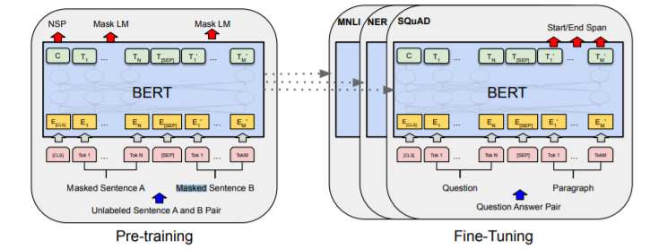
BERT: Masked Language Model (MLM)
To deal with the issue of a word seeing itself from different word’s representing vectors:
BERT masked a percentage of words randomly to prevent a word seeing itself.
Notes:
To deal with the issue of a word seeing itself from different word’s representing vectors:
BERT masked a percentage of words randomly to prevent a word seeing itself.

Slide 14
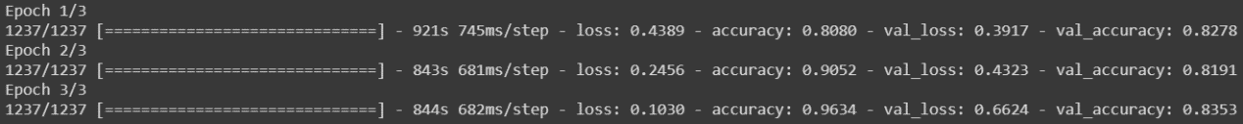
BERT: Final results
I chose to adopt the standard BERT consists of 12 encoder layers with 110 million parameters. The other participants used the large BERT which consists of 24 encoder layers tends to spend three times longer in training while having a similar score.
The training process from the small BERT
The training process from the large BERT
The small BERT can be trained significantly faster, while maintaining similar accuracy compare to the large BERT.
Notes:
I chose to adopt the standard BERT consists of 12 encoder layers with 110 million parameters. The other participants used the large BERT which consists of 24 encoder layers tends to spend three times longer in training while having a similar score. The small BERT can be trained significantly faster, while maintaining similar accuracy compare to the large BERT.

Slide 15
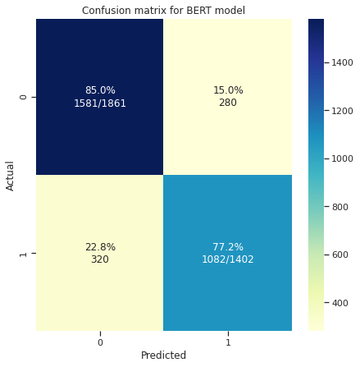
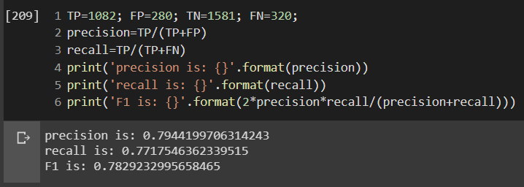
BERT: Final results
The small BERT model also takes less time to predict.
In addition: the saved weight of the model is 1GB, while the large BERT model is 4 times of that.
Notes:
The small BERT model also takes less time to predict.
In addition: the saved weight of the model is 1GB, while the large BERT model is 4 times of that.

Slide 16

BERT: Final results
The mistaken predictions generally have complex text.
Notably, some of the tweets are naturally ambiguous given only the text.There are some slogan, advertisement and rant. These tweets do convey disaster-related ideas. It is understandable for them to be predicted wrongly.
Lastly, some of the keyword assignment from the dataset is difficult to understand. For example, tweet 350 is about saving wild horses, but it was assigned with the keyword ‘annihilation’.
I also saved the erroneous predications to a csv.
Notes:
The mistaken predictions generally have complex text. Notably, some of the tweets are naturally ambiguous given only the text. There are some slogan, advertisement and rant. These tweets do convey disaster-related ideas. It is understandable for them to be predicted wrongly.
Lastly, some of the keyword assignment from the dataset is difficult to understand. For example, tweet 350 is about saving wild horses, but it was assigned with the keyword ‘annihilation’.

Slide 17
Conclusion
The BERT model consists of 12 encoder layers with 110 million parameters was used to do the text classification task.
The BERT model has the advantage of learning the context of a text compare to the other neural network model.
The BERT model in use can trained significantly faster than the large BERT model.
The BERT model also predict faster than the large BERT model.
The BERT model’s saved weight is 1 fourth of the large BERT model’s saved weight.
Notes:
The BERT model consists of 12 encoder layers with 110 million parameters was used to do the text classification task.
The BERT model has the advantage of learning the context of a text compare to the other neural network model.
The BERT model in use can trained significantly faster than the large BERT model.
The BERT model also predict faster than the large BERT model.
The BERT model’s saved weight is 1 fourth of the large BERT model’s saved weight.

